Slide 1
CSS Grid - Introduction
Grid is a two-dimensional layout system allowing precise placement of items in rows and columns.

Slide 2
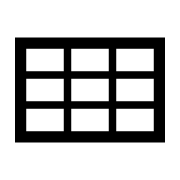
Why We Use CSS Grid?
Provides a powerful, flexible layout system for web pages
Helps designers align content in rows and columns easily
Useful for complex layouts that are hard with Flexbox alone
Supports responsive design with fractional units and auto-fit
Improves consistency and structure across screen sizes

Slide 3
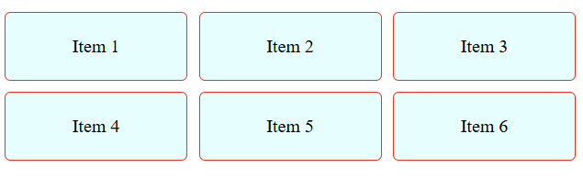
Grid Container Properties
.container {
display: grid;
grid-template-columns: repeat(3, 1fr);
grid-gap: 10px;
}
<div class="container">
<div class="item">Item 1</div>
<div class="item">Item 2</div>
<div class="item">Item 3</div>
<div class="item">Item 4</div>
<div class="item">Item 5</div>
<div class="item">Item 6</div>
</div>
view

Slide 4
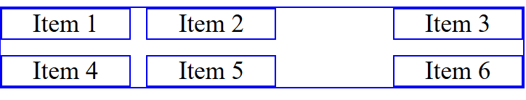
Basic Grid Layout
.container {
display: grid;
grid-template-columns: 1fr 2fr 1fr;
}
<div class="container">
<div class="item1">Item 1</div>
<div class="item2">Item 2</div>
<div class="item3">Item 3</div>
<div class="item4">Item 4</div>
</div>
view

Slide 5
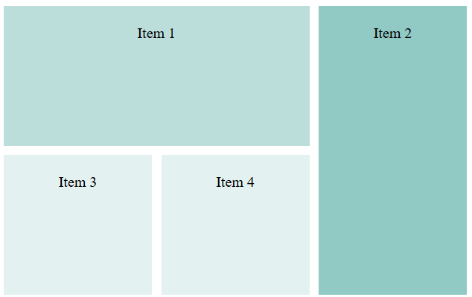
Grid Item positioning
.container {
display: grid;
grid-template-columns: repeat(3, 1fr);
grid-template-rows: repeat(2, 150px);
gap: 10px;
}
.item1 {
grid-column: 1/3;
grid-row: 1/2;
}
.item2 {
grid-column: 3/4;
grid-row: 1/3;
}
<div class="container">
<div class="item1">Item 1</div>
<div class="item2">Item 2</div>
<div class="item3">Item 3</div>
<div class="item4">Item 4</div>
</div>
view

Slide 6
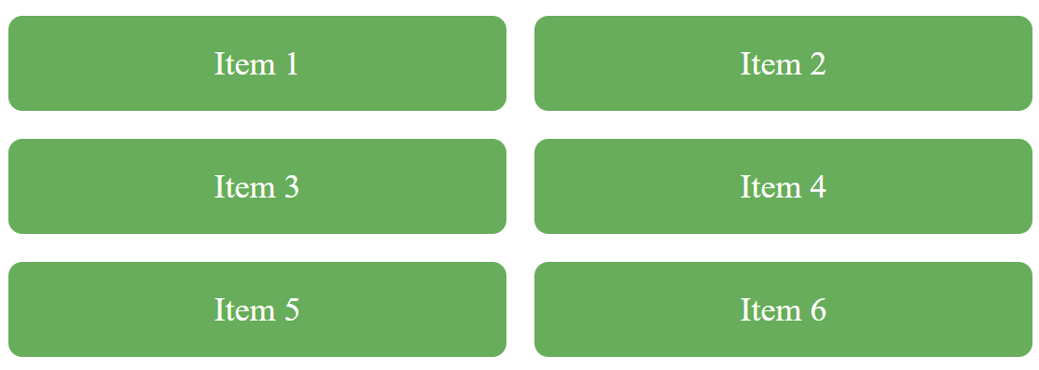
Responsive Grid Gallery
Each column should be at least 200px wide, but if there is more room, let it expand and share space equally.
Below shows what happens when display shrinks.
.container {
display: grid;
grid-template-columns: repeat(auto-fit, minmax(200px, 1fr));
gap: 1rem;
}
view

Slide 7
Stacking Containers
.grid {
display: grid;
grid-template-columns: repeat(auto-fit, minmax(250px,1fr));
}
@container (min-width: 400px) {
.card-content {
flex-direction: row;
}
}
💡 Cards adapt independently when container width passes 400px.
demo

Slide 8
Responsive SPA Grid
💡 Sidebar stacks below content on smaller screens.
.app {
display: grid;
grid-template-areas: 'sidebar content';
grid-template-columns: 200px 1fr;
}
@media (max-width: 800px) {
.app {
grid-template-areas: 'content' 'sidebar';
}
}
view

Slide 9
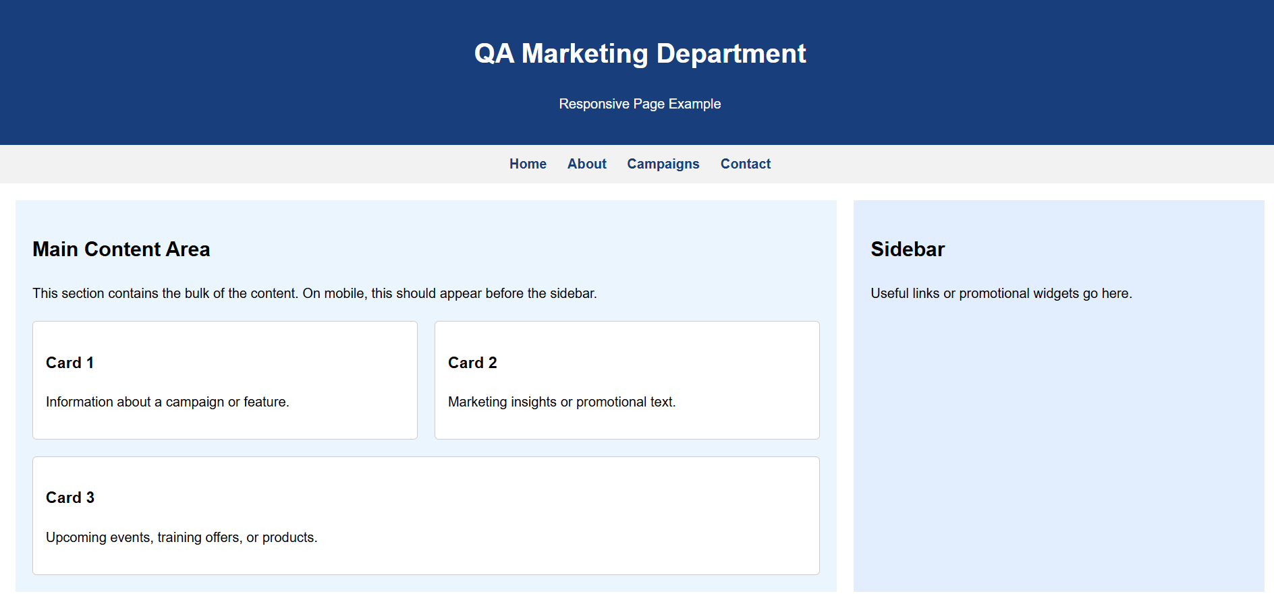
Lab - Combined Layout
Create a page as seen below Header: Flexbox - Main section: Grid with sidebar and content Footer: Flex with centered text and icons
Use media queries for mobile responsiveness.

Slide 10
Summary
In this chapter, you discovered how to use Grids to create a Responsive web page

